Slide 1
DEVELOPMENT OF INTERATRIAL AND INTERVENTRICULAR SEPTUM himanshu gupta

Slide 2
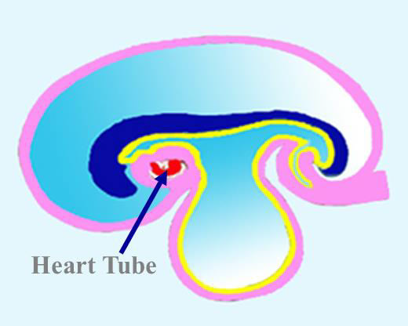
Introduction to development of the heart
It develops early in the middle of 3rd week , from aggregation of splanchnic mesodermal cells, in cardiogenic area, ventral to pericardial coelom, and dorsal to yolk sac.
They form 2 angioblastic cords that canalize to form 2 endocardial heart tubes.

Slide 3
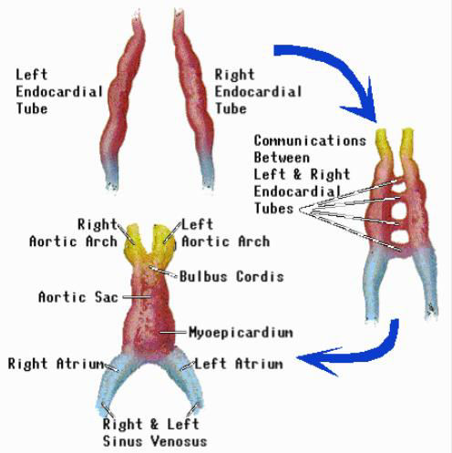
The Heart Tube
The two endocardial tubes fuse to form Single heart tube.

Slide 4
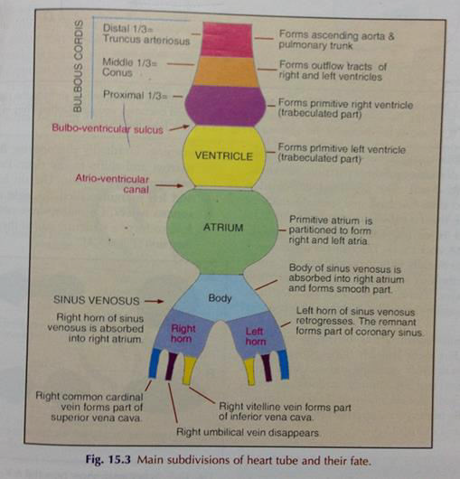
The heart tube is differentiated into:
1-truncus arteriosus.
2-bulbus cordis.
3-primitive ventricle.
4-primitive atrium.
5-sinus venosus.

Slide 5
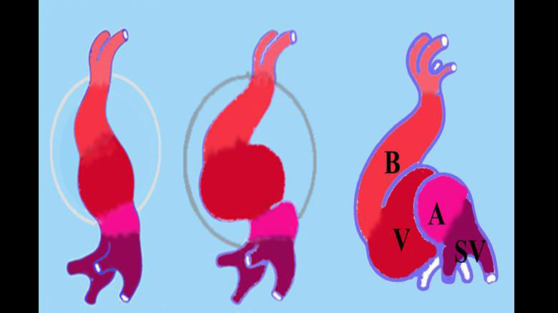
Folding of the heart tube
During the 4th week, the folding of the heart tube takes place.
The formation of the AV canal and the endocardial cushions also take place around the same time.

Slide 6
FORMATION OF CARDIAC SEPTA
The major septa of the heart are formed between the 27th and 37th days of development.
When the embryo grows in length from 5 mm to approx. 16 to 17 mm.
Septum formation can involves-
Endocardial cushions formation
Passive expansion of chambers

Slide 7
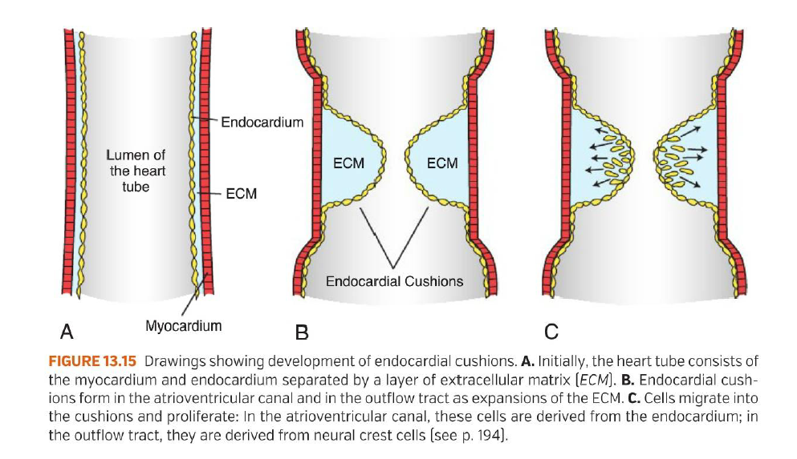

Slide 8
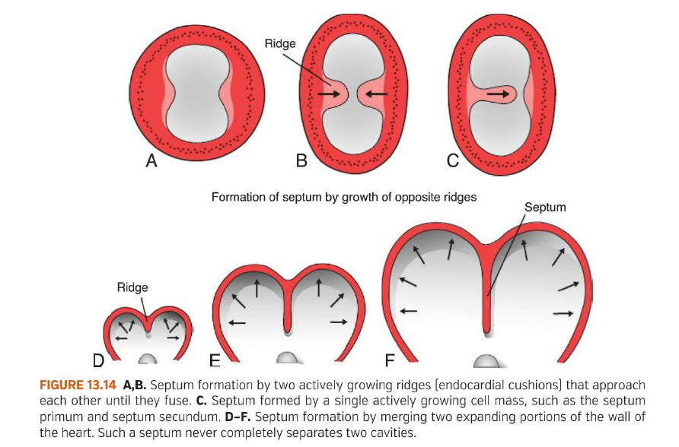

Slide 9
Formation of the Cardiac Septa
The Atrioventricular (AV) septum
Atrial septum
Interventricular septum
Aorticopulmonary septum

Slide 10
Molecular regulation of septal development
NKX2.5.-the master gene for heart development
BMPs 2 and 4
WNT protein inhibitors-CRESCENT and CERBERUS
FGF8
Retinoic acid
TBX5- DNA- binding motif known as the T-box. Expressed later than NKX2.5, it plays an important role in septation.

Slide 11
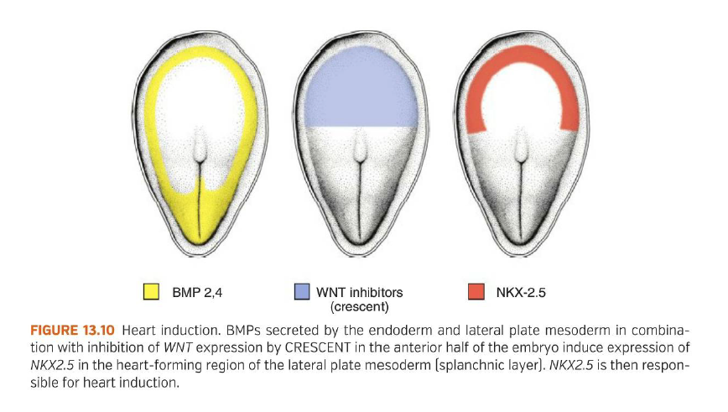

Slide 12
Partitioning of the primitive Heart
Division of A-V canal , primitive atrium & primitive ventricle begins at the middle or end of 4th week and completed by the end of 5th week.
These processes occur concurrently.
At the end of 4th week, 2 endocardial cushions on dorsal & ventral walls of atrioventricular canal , develop from mesenchymal cells of cardiac jelly.

Slide 13
During 5th week, the AV- endocardial cushions meet and unite in the mid line to form a septum and divide the common A-V canal into right & left A-V canals.
Endocardial cushions also form the AV- valves + membranous septa of interventricular septum.
Note in D, coronal section ,begining of development of interatrial & intervent. septa.

Slide 14
Formation of the Interatrial septum.
The septum is developed from three sources:
1. Septum primum
2. Septum intermedium
3. Septum secundum

Slide 15
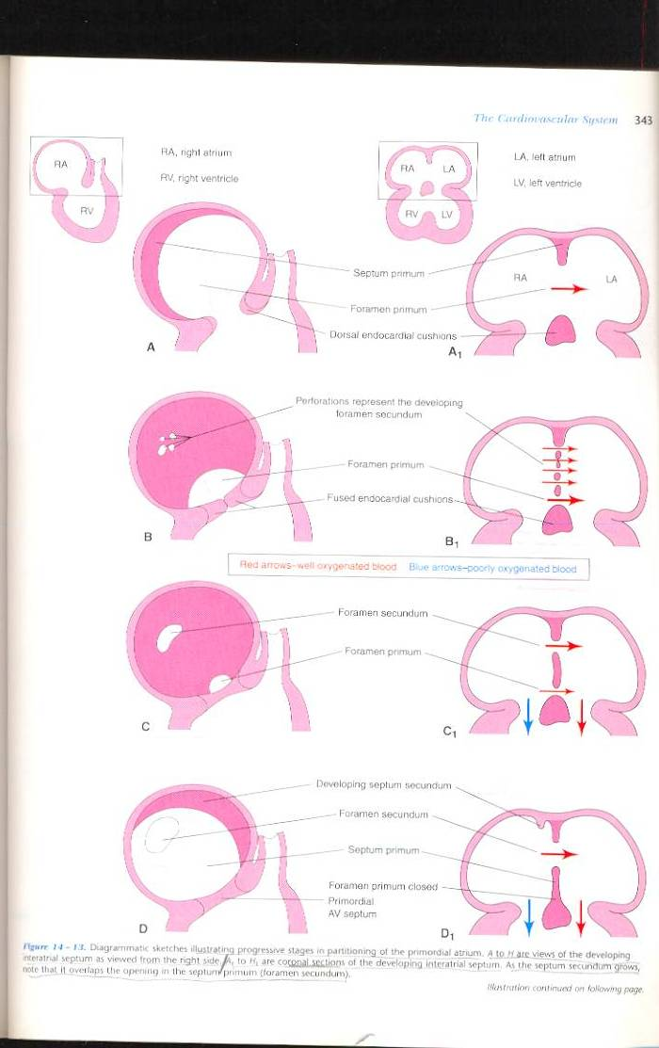
1-Septum primum :
A thin crescent-shaped membrane grows from the roof of common atrium.
The lower margin of the septum is free and concave.
Anterior and posterior horns of the septum fuse respectively with the ventral and dorsal endocardial cushions of the primitive atrioventricular canal.
2-Septum intermedium:
The ventral and dorsal cushions of the atrioventricular canal fuse to form a broad anterioposterior partition, which divide the canal into right and left atrioventricular orifices.

Slide 16
A foramen known as ostium primum is formed between the upper surface of septum intermedium and lower border of septum primum.
Later, ostium primum is closed by the fusion of two septa.
Associated with the closure of ostium primum, the upper and dorsal part of septum disintegrates forming a foramen known as ostium secundum.

Slide 17
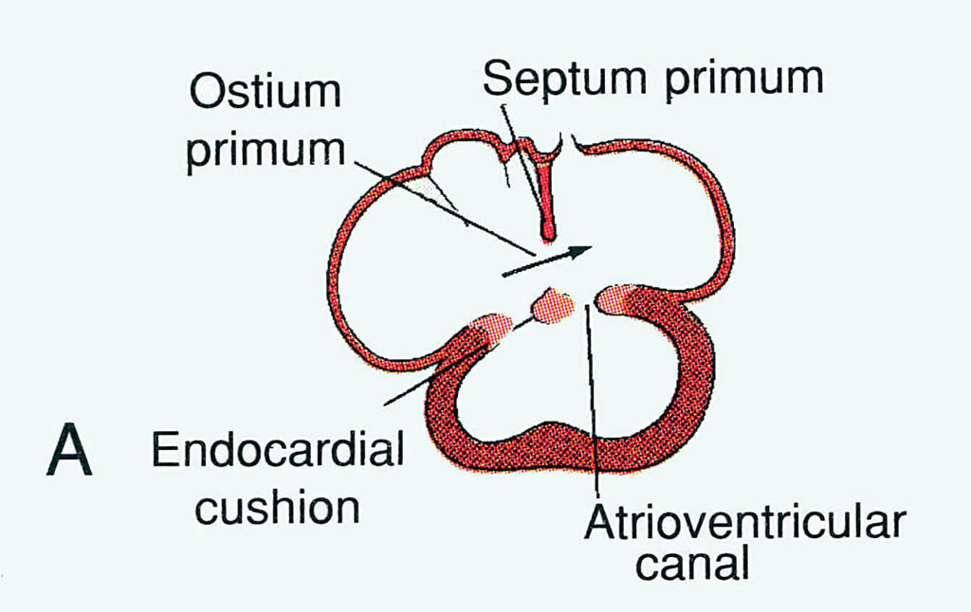

Slide 18
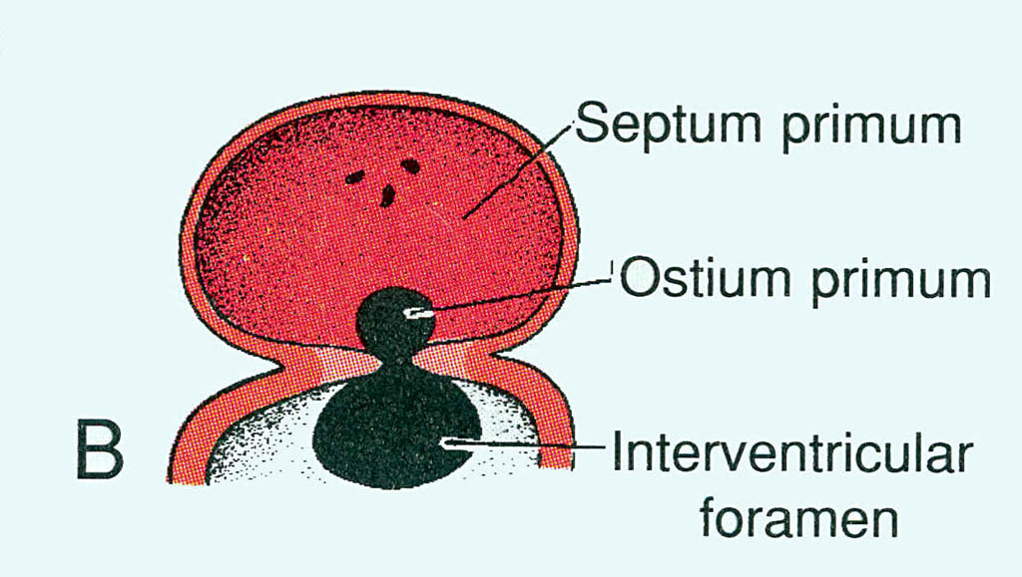

Slide 19
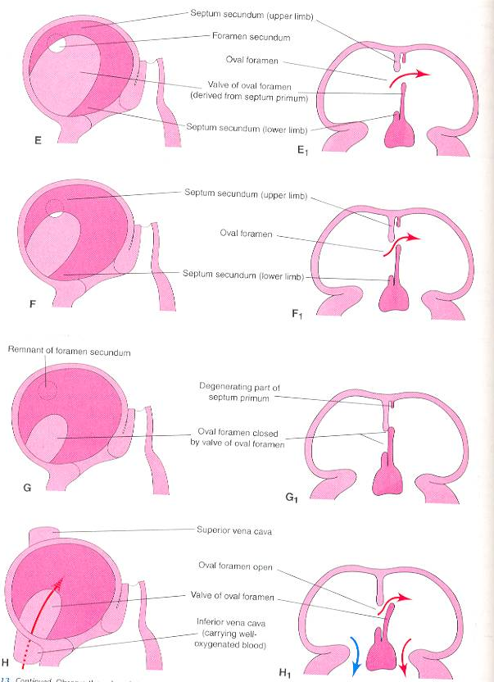
3-Septum secundum-
It arises on the right side of septum primum from the space of the right atrium which is interval between septum primum and septum spurium.
The septum secundum incorporates the whole of left venous valve and extends vertically downwards.
The lower margin grows sufficiently to overlap the upper margin of the septum primum.
The valvular opening formed between the lower margin of the septum secundum and upper margin of the septum primum is called foramen ovale.

Slide 20
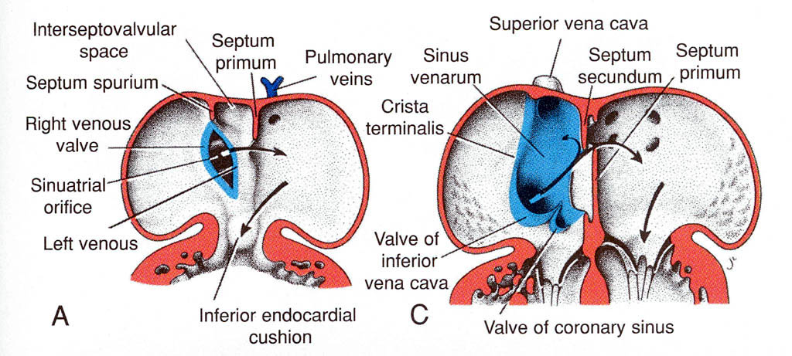

Slide 21
In the fetus (before birth)
RAP > LAP, oxygenated blood flows directly from right atrium to left atrium through open foramen ovale.
After birth-
when pulmonary circulation begins, LAP rises and the upper edge of septum primum is pressed against the upper limb of septum secundum.
This closes the foramen ovale ,forming a complete partition between the 2 atria.
An oval depression in the lower part of interatrial septum of right atrium…. The fossa ovalis is a remnant of the foramen ovale.

Slide 22
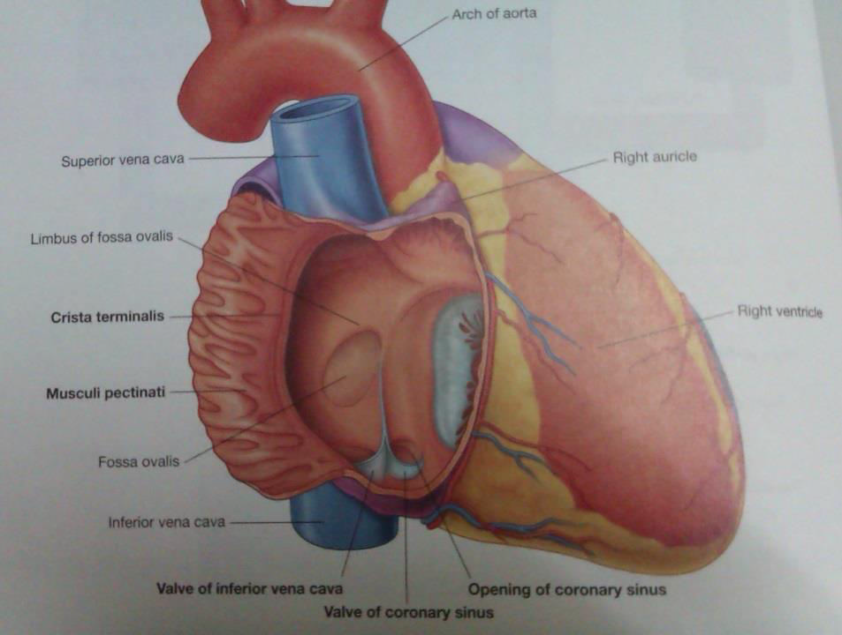
Features of the interatrial septum
On the right side:
1. Fossa ovalis: Oval depression in the lower part of the septum, and the floor is formed by the septum primum.
2. Limbus fossa ovalis: a sickle shaped fold that surrounds the upper, anterior and posterior margins of the fossa ovalis. It represents lower free margins of the septum secundum.
3. Foramina venarium minimarium: Venae cordis minimi open through these foramina.
4. Atrio-ventricular node: It is situated in the lower part of the septum above the opening of coronary sinus.

Slide 23
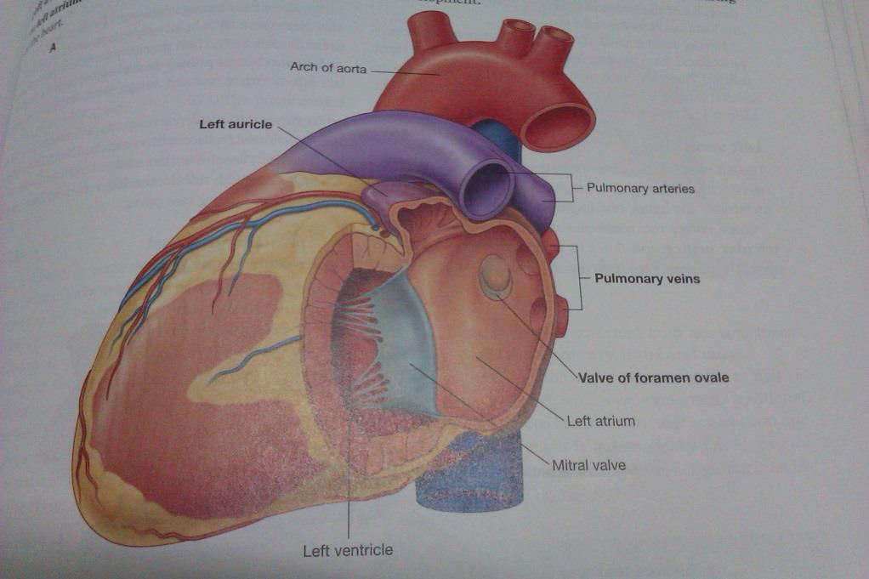
On the left side:
1. Presence of the semilunar fold with the concavity directed upwards; it is a remnant of the upper margin of the septum primum.
2. Lunate impression above the fold is formed by septum secundum.
3. Foramina venarium minimarium.

Slide 24
Development of IVS

Slide 25
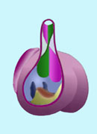
Ventricular Septum
Membranous
Spiral
(Aorticopulmonary)
Muscular

Slide 26
Development of muscular part of IVS:
Primordial muscular IVS arises in the floor of ventricle , as thick crescentic fold with concave free edge.
This septum subdivides the original ventricular cavity incompletely into right & left ventricles that communicate together through IV foramen.
This foramen closes by the end of 7th week as the 2 bulbar ridges fuse with the endocadial cushion.
A-sagittal section 5th week.
Coronal section.6th week.

Slide 27
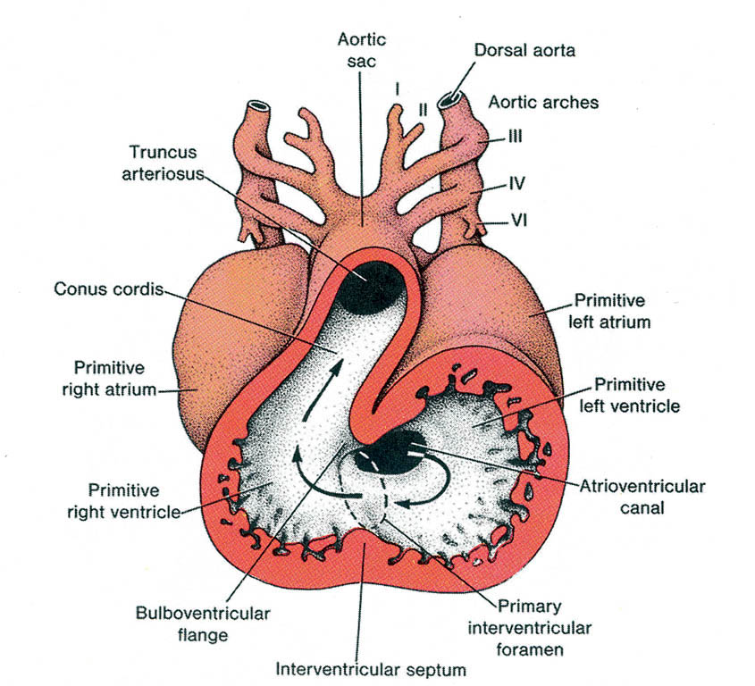

Slide 28
Incorporation of the proximal part of bulbus cordis into the ventricles
A sagittal s.at 5th w., showing the bulbus cordis in the primitive heart.
B coronal s.at 6th w. after incorporation of the proximal part of bulbus cordis into the ventricles to forms :
In right ventricle …Conus arteriosus (infundibulum), which gives origin of pulmonary trunk.
In left ventricle…. Aortic vestibule part of ventricular cavity just inferior to aortic valve.

Slide 29
Closure of IV foramen & formation of membranous part of IV septum result from fusion of the following :
1-right bulbar ridge.
2-left bulbuar rige.
3-fused endocardial cushions.

Slide 30
B, coronal s. at 6th w. after incorporation of the proximal part of bulbus cordis into the ventricles.
C,5th w., showing the bulbar ridges & fused endocardial cushions.
D,6th w., proliferation of endocardial cushions to diminish I V foramen.
E,7th w., fusion of bulbar ridges + extensions of endocardial cushions upward with aortico-pulmonary septum and down with muscular I V septum to close I V foramen , so memb. IV septum is formed

Slide 31
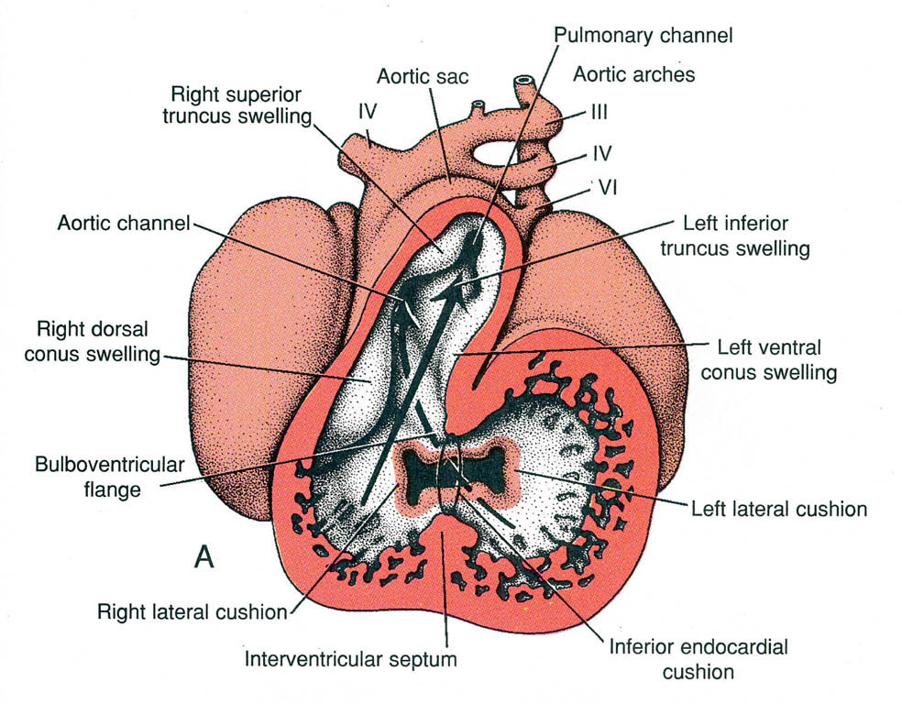

Slide 32
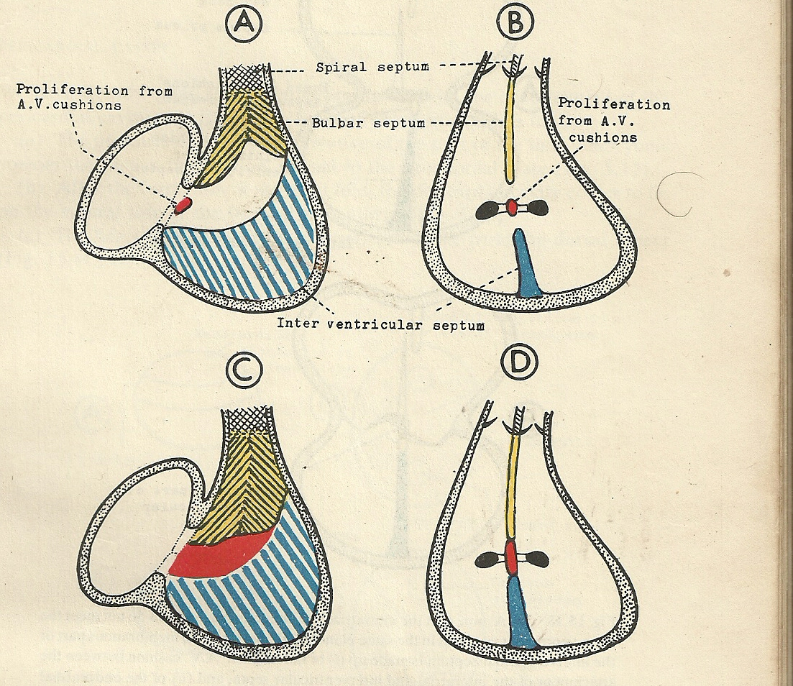

Slide 33
Atrial Septal Defects

Slide 34
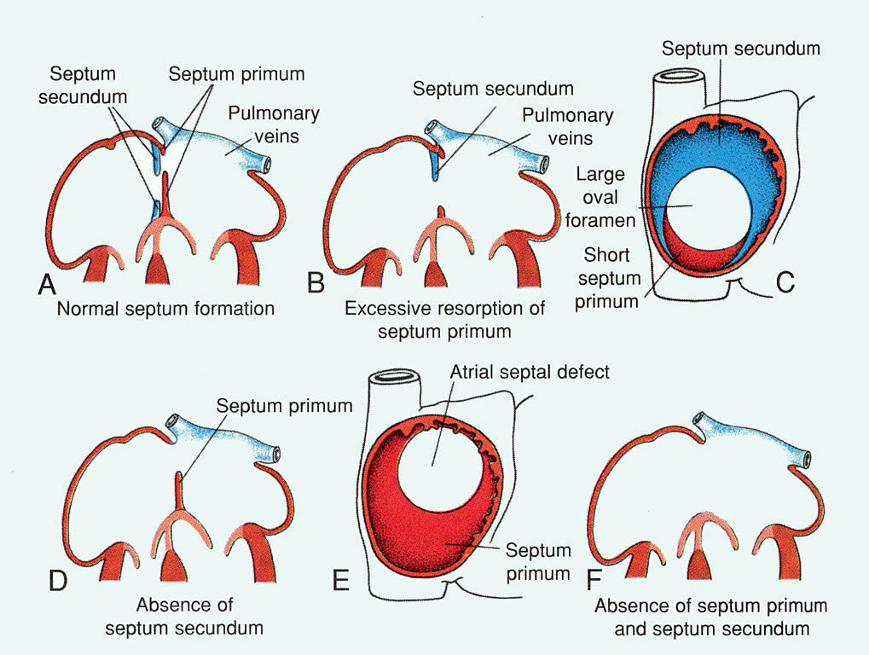

Slide 35
Introduction
ASD detected in 1 child per 1500 live births, and accounts for 5-10% of congenital heart defects.
Make up 30-40% of all congenital heart disease detected in adults (second only to bicuspid aortic valve).
ASDs occur in women 2-3 times as often as men.

Slide 36
Introduction
ASDs can occur in different anatomic portions of the atrial septum.
can be isolated or occur with other congenital cardiac anomalies.
Functional consequences of ASDs are related to the anatomic location of the defect, its size, and the presence or absence of other cardiac anomalies.

Slide 37
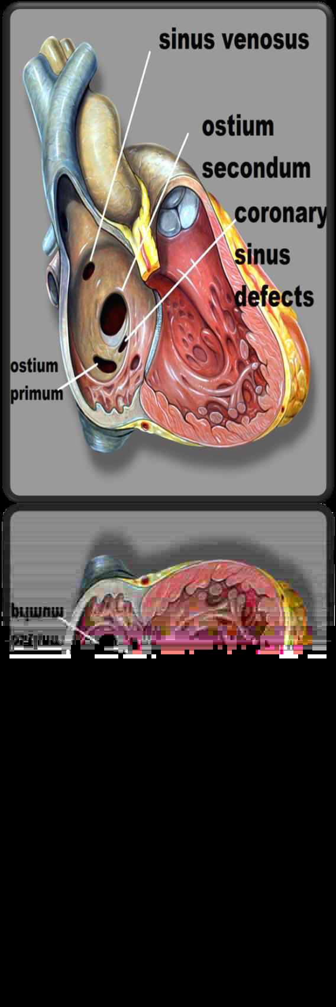
Classification
Primum ASD
Secundum ASD
Sinus venosus defects
Coronary sinus defects
Patent foramen ovale

Slide 38
Primum ASD
Make upto 15% of all ASDs.
Occur if the septum primum does not fuse with the endocardial cushions, leaving a large defect at the base of the interatrial septum.
Usually not isolated – primum ASDs are typically associated with anomalies of the AV valves (such as cleft mitral valve) and defects of the ventricular septum (VSDs) or a common AV canal.

Slide 39
Secundum ASD
Make up ~70% of all ASDs.
Occur twice as often in females.
Typically located within the area bordered by the limbus of the fossa ovalis.
Defects vary in size, from <3 mm to >20 mm.

Slide 40
Secundum ASD
May be associated with other ASDs.
Multiple defects can be seen if the floor of the fossa ovalis (AKA valve of the foramen ovale) is fenestrated.
Ten to twenty percent have a functional mitral valve prolapse
May be related to changing LV geometry associated with RV volume overload

Slide 41
Sinus venosus ASD
Make up ~10% of ASDs.
Characterized by malposition of the insertion of the SVC or IVC straddling the atrial septum.
Often associated with anomalous pulmonary venous return – the RUL/RML pulmonary veins may connect with the junction of the SVC and RA in the setting of a superior sinus venosus ASD.

Slide 42
Coronary Sinus Septal Defects
Less than 1% of ASDs
Defects in the inferior/anterior atrial septum region that includes the coronary sinus orifice.
Defect of at least a portion of the common wall separating the coronary sinus and the left atrium – AKA “unroofed coronary sinus”
Can be associated with a persistent left SVC draining into the coronary sinus.

Slide 43
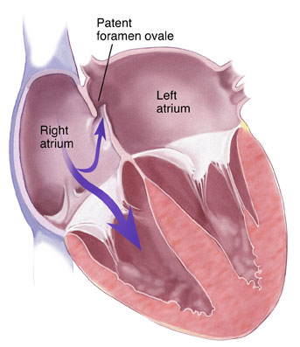
Patent Foramen Ovale
Not truly an “ASD” because no septal tissue is missing.
Oxygenated blood from the IVC crosses the foramen ovale in utero.
At birth, the flap normally closes due to
Reduced right heart pressure and PVR
Elevated LA pressure.
Flap fusion is complete by age two in 70-75% of children; the remainder have a PFO.

Slide 44
Other congenital anomalies
Probe patency of foramen ovale: It takes place when the foramen is closed functionally, but remains patent anatomically.
These subjects are considered as normal.
Biventricular mono-atrial heart: This is due to complete failure of the septation of primitive atrium.
Pre-natal closure of foramen ovale: This is a rare anomaly.

Slide 45
Cor Triatriatum Dexter :
Complete persistence of the right venous valve produces a septum in the right atrium
Separates the intercaval part of the right atrium from the atrial body. The remaining opening may be quite small and restrictive
Persistent Left Superior Vena Cava :
Persistence of the left common cardinal vein and left sinus horn results in a left superior vena cava draining into the coronary sinus

Slide 47
Cor Triatriatum Sinister
Incorporation of the common pulmonary vein into the left atrium does not take place
common pulmonary venous ostium remains narrow
results in a septum- that divides the left atrium into two components:
One receives the pulmonary veins, and the
other has access to MV and the left atrial appendage

Slide 48
VENTRICULAR SEPTAL DEFECT

Slide 49
VSD is a defect in the ventricular septum
Most common congenital cardiac anomalies.
3-3.8 per 1000 live births
30-60% of all newborns with a CHD
The membranous portion-most commonly affected in adults and older children
Prospective studies give a prevalence of 2-5 per 100 births of trabecular VSDs that closes shortly after birth in 80-90% of the cases

Slide 50
Classification
Perimembranous(membranous/infracristal)70-80%
Muscular- 5-20%
Central- mid muscular
Apical
Marginal- along RV septal junction
Swiss cheese septum – multiple defects
Inlet/ AV canal type-5-8%
Supracrital/ subaortic- 5-7%

Slide 51
Location of VSDs
outlet
Muscular
perimembranous
Inlet
Swiss cheese

Slide 52
Types of VSD

Slide 53
Small VSD in infancy
<1/3rd size of aortic root
shunt limited by size of the defect
Shunt entirely during ventricular systole
L→ R shunt <50% LV output
Pulmonary:systemic flow ratio < 2:1

Slide 54
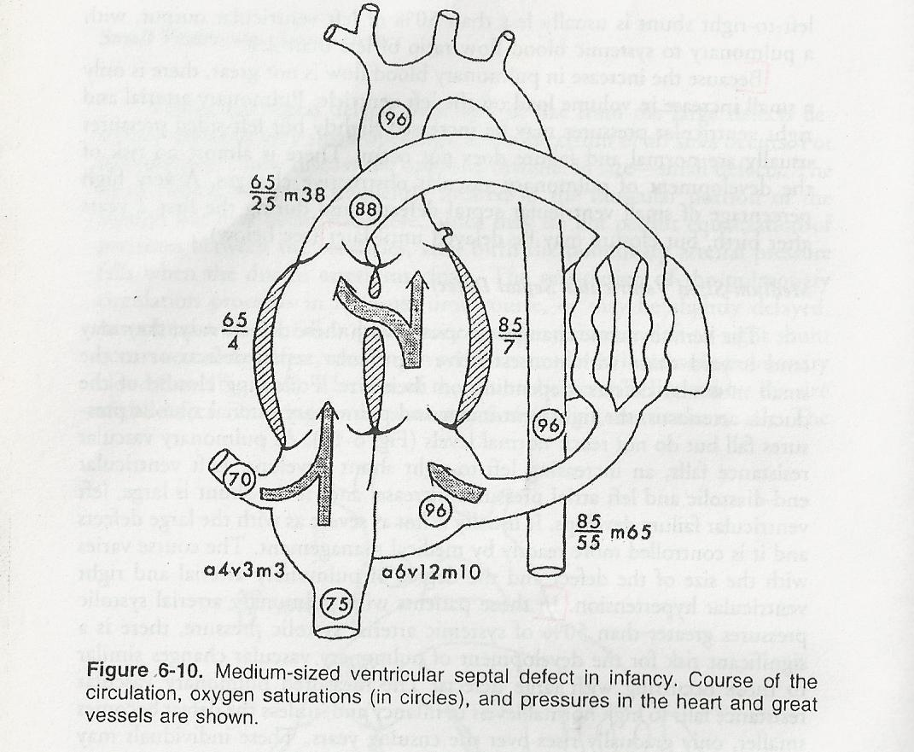
Medium sized VSD
VSD size about half – equal to the size of the aortic orifice
When PA & RVSP are > 50% of systemic arterial pressure
mod-large L→ R shunt develops

Slide 55
Large VSD
Size equal to the aortic root
Equalization of pressures in RV& LV
Increased LA pressure→ opening of foramen ovale

Slide 56
Hemodynamic classification
Restrictive- resistance that limits the shunt at the site of vsd
LVSP > RVSP
pulm /aortic systolic pressure ratio < 0.3
Qp / Qs < 1.4/1
Moderately restrictive - RVSP high, but less than LVSP
- Qp/Qs 1.4-2.2
Non restrictive -Shunt not limited at the site of defect
RVSP , LVSP, PA , Aortic systolic pressures equal
Qp/Qs >2.2
Flow determined by PVR

Slide 57
Natural history
Spontaneous closure :75-85 % all VSDs
:35% perimemb ( 1st 6/12)
More frequent in small defects
Decrease in size with age
Inlet & outlet defects do not become smaller /close spont
Large & nonrestrictive defects : 10- 15%
Endocarditis – risk of endocarditis 4-10% for the first 30 years of life
High velocity turbulent jet into RV

Slide 58
CHF
Large VSDs
Mod sized VSDs survive into adulthood
Increased rt sided flow → pulmonary vascular disease → Eisenmenger’s physiology if left untreated

Slide 59
Mechanisms of closure
Growth & hypertrophy of septum around the defect
By development of subacute bacterial endocarditis
Adherence of septal tissue to the margins
(Negative pressure effect exerted by a high velocity stream flowing through the defect )
Ventricular septal aneurysm
prolapse of aortic cusp
intrusion of a sinus of valsalva aneurysm

Slide 60
VSD with AR
Peri membranous VSD with AR - 5-8%
Subarterial VSDs – 30%
Sagging or herniation of RCC or RCC+ NCC
May cause RVOT obstruction
Due to morphological abnormality of valve
LV volume – regurgitant volume & shunt volume
VSD murmur dates from infancy
AR murmur appears (5-9 yrs)

Slide 61
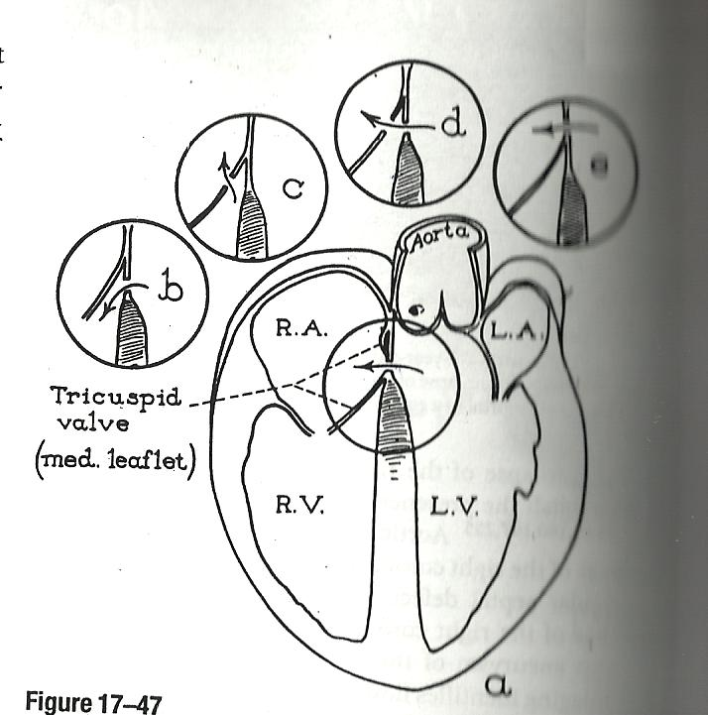
LV → RA shunt
Gerbode defect
Shunt begins in utero
Usually restrictive
Rightward thoracic position of murmur
X ray – RA enlargement disproportionate to the size of pulmonary trunk

Slide 62
THANK YOU

